Slide 1
Crisis consume cooperative
All you have to know about a Co-operative
1º C&D bach. Bil.

Slide 2
What’s a co-operative?
A cooperative or a co-operative is an autonomous association of persons who voluntarily cooperate for their mutual social, economic, and cultural benefit. Cooperatives include non-profit community organizations and businesses that are owned and managed by the people who use its services (a consumer cooperative) and/or by the people who work there (a worker cooperative).

Slide 3
the cooperative principles:
Voluntary and Open Membership
Democratic Member Control
Member Economic Participation
Autonomy and Independence
Education, Training and Information
Cooperation among Cooperatives
Concern for Community

Slide 4
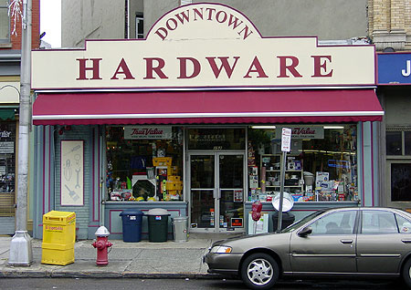
Types of co-operative
Retailers' cooperative
A retailers' cooperative is an organization which employs economies of scale on behalf of its members to receive discounts from manufacturers and to pool marketing. It is common for hardware stores and pharmacies. In this case the members of the cooperative are businesses rather than individuals.

Slide 5
Worker cooperative
A worker cooperative or producer cooperative is a cooperative, that is owned and democratically controlled by its "worker-owners". There are no outside owners in a "pure" workers' cooperative, only the workers own shares of the business, though hybrid forms exist in which consumers, community members or capitalist investors also own some shares.

Slide 6
OUR OWN CO-OPERATIVE
WHAT TYPE OF CO-OPERATIVE IS IT?
Our cooperative (CRISIS CONSUME COOPERATIVE) is a
volunteer cooperative.
This type of cooperative is organized by and for a network of volunteers, for the benefit of a defined membership or the general public, to achieve some goal. Depending on the structure, it may be a collective or mutual organization, which is operated according to the principles of cooperative governance. The most basic form of volunteer-run cooperative is a voluntary association. A social club may be organized on this basis. A volunteer-run co-op is distinguished from a worker cooperative in that the latter is by definition employee-owned, whereas the volunteer cooperative is typically a non-stock corporation, volunteer-run consumer co-op or service organization, in which workers and beneficiaries jointly participate in management decisions and receive discounts on the basis of sweat equity.

Slide 7
Cooperative education
The “Crisis Consume Cooperative” is also a
cooperative education.
It’s a structured method of combining classroom-based education with practical work experience. A cooperative education experience, commonly known as a "co-op", provides academic credit for structured job experience. Cooperative education is taking on new importance in helping young people to make the school-to-work transition, service learning, and experiential learning initiatives.

